Slide 1
Our Prep
Before travel
Have a fallback for WiFi outage
Download these slides as PDF
Clone repo with latest version of https://colab.research.google.com/github/DJCordhose/practical-llm
On Site
Figure out speaker WiFi
Show prerequisites as first slide before beginning of workshop

Slide 2
Prerequisites - Running LLMs on Prem
Create a Google Account (if you do not have one, yet): https://accounts.google.com/
Login with that account into Google Colab: https://colab.research.google.com/
Create a Huggingface account (if you do not have one, yet): https://huggingface.co/join
Create an access token and save it for later use in the notebooks: https://huggingface.co/settings/tokens
Request access to gated Huggingface models:
https://huggingface.co/meta-llama/Meta-Llama-3.1-8B-Instruct
https://huggingface.co/google/gemma-2-2b-it
Make sure you can open the workshop notebooks in Colab: https://colab.research.google.com/github/DJCordhose/practical-llm

Slide 3
Running LLMs on prem
A Practical Guide

Slide 4
Why self hosting an LLM?
You might want control over
Privacy / data protection
Availability and Scaling
Latency
Limitations
Cost of operation
Ecological footprint
Stability

Slide 5

Architecture Decision: self-hosting ?
Decision : yes
Key-Driver : privacy, version stability, limitations
Challenge : which LLM ? Does it run on your hardware ?
Surprises : operating GPUs is really hard
Failures
Power
Stability
Complexity, Work, Troubles

Slide 6
This workshop is about solving the challenges arising from self hosting

Slide 7
Who are we?
Christian
Olli

Slide 8
LLM Intro

Slide 9
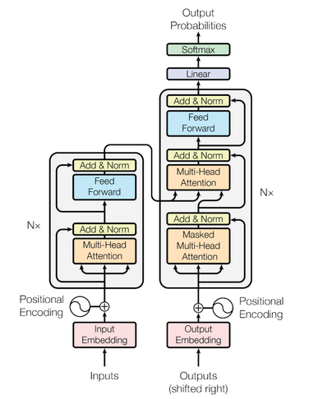
Transformers, LLMs, Encoder, Decoder: WTF?
Transformers: A flexible architecture that uses self-attention to process sequential data efficiently.
LLMs: Large-scale Transformer models trained on extensive text datasets to perform various language tasks.
Encoder Models: Part of the Transformer architecture focused on understanding and interpreting input data (e.g. BERT)
Decoder Models: Part of the Transformer architecture focused on generating sequential output based on the interpreted inputs or prior outputs (e.g. GPT)

Slide 10
Decoder Models

Slide 11
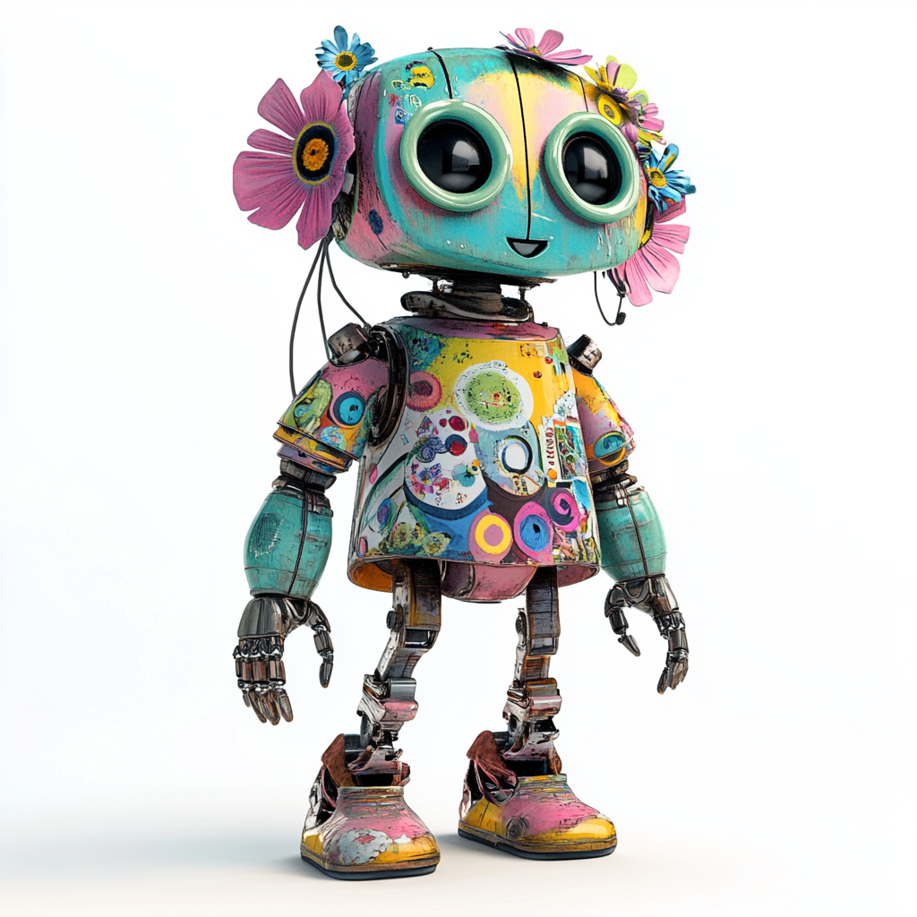
How does a Decoder Model work ?
Q: what is pluvia ?
A:
Depends on users goal
Unique for each chat & user
Contains the chat history
«the context»
Trained on huge datasets
Does not change
Same for all users
«the model»

Slide 12
How does an LLM work ?
Q: what is pluvia ?
A:
Pluvia
Depends on users goal
Unique for each chat & user
Contains the chat history
«the context»
Trained on huge datasets
Does not change
Same for all users
«the model»
Single «word»
Depends on context and model
«the token»

Slide 13
How does an LLM work ?
Q: what is pluvia ?
A: Pluvia
is
Depends on users goal
Unique for each chat & user
Contains the chat history
«the context»
Trained on huge datasets
Does not change
Same for all users
«the model»
Single «word»
Depends on context and model
«the token»

Slide 14
How does an LLM work ?
Q: what is pluvia ?
A: Pluvia is
a
Depends on users goal
Unique for each chat & user
Contains the chat history
«the context»
Trained on huge datasets
Does not change
Same for all users
«the model»
Single «word»
Depends on context and model
«the token»
Represented as an int id

Slide 15
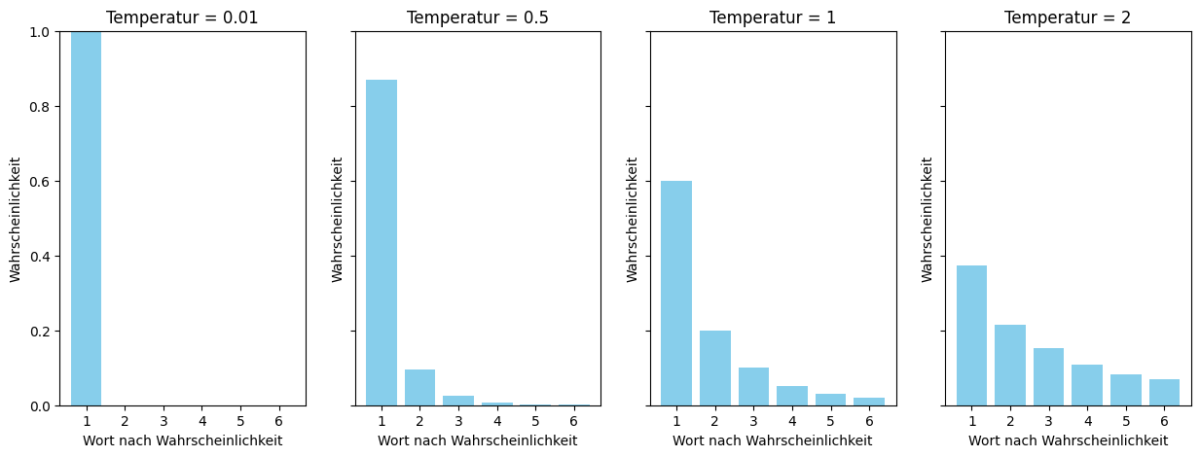
How does an LLM work ?
Q: what is pluvia ?
A: Pluvia is a
2.78
0.02
98.7
-23
…
latin
[312, 2,17,…]
Depends on users goal
Unique for each chat & user
Contains the chat history
«the context»
A list of token ids
Trained on huge datasets
Does not change
Same for all users
«the model»
Output a probability distribution over token ids
Single «word»
Depends on context and model
«the token»
Represented as an int id

Slide 16
How does an LLM work ?
Q: what is pluvia ?
A: Pluvia is a latin
4
17.2
-33
0.01
…
…
[312, 2,17,…]
Depends on users goal
Unique for each chat & user
Contains the chat history
«the context»
A list of token ids
Trained on huge datasets
Does not change
Same for all users
«the model»
Output a probability distribution over token ids
Single «word»
Depends on context and model
«the token»
Represented as an int id

Slide 17
How does an LLM work ?
Q: what is pluvia ?
A: Pluvia is a latin word meaning rainfall.
0.2
29.4
95
567
…
EOT
[312, 2,17,…]
Depends on users goal
Unique for each chat & user
Contains the chat history
«the context»
A list of token ids
Trained on huge datasets
Does not change
Same for all users
«the model»
Output a probability distribution over token ids
Single «word»
Depends on context and model
«the token»
Represented as an int id

Slide 18
Decoder On-Prem Challenges
Context sizes vary (depending on the Model)
with large contexts certain positions might be blind spots
Memory consumption grows with context used
Response time grows with tokens produced
Inference on GPU only

Slide 19
Comparing suitable NVDIA GPU microarchitectures
Commodity: available for small €
T4/RTX 20: https://en.wikipedia.org/wiki/Turing_(microarchitecture)
V100 - professional variant of RTX 20 consumer line: https://en.wikipedia.org/wiki/Volta_(microarchitecture)
A100/RTX 30: https://en.wikipedia.org/wiki/Ampere_(microarchitecture)
L4/L40/RTX 40: https://en.wikipedia.org/wiki/Ada_Lovelace_(microarchitecture)
H100 - professional variant of RTX 40 consumer line, not available on Colab (yet?): https://en.wikipedia.org/wiki/Hopper_(microarchitecture)

Slide 20
Architecture Decision: What can we work with?
Limiting factor is GPU RAM
T4 : 16GB
A100 : 40GB/80GB
L4 : 24GB (L40: 48GB)

Slide 21
Limiting factor is GPU RAM: Quantization
Typical resolution is 16 Bit
Each parameter takes 2 Bytes
Transient memory and storage of context comes on top
Varies with
length of context
architecture of model
What about reducing resolution to 8 Bit or 4 Bit (and even 1 Bit)?
Thus cutting memory requirement down to half or quarter?
Overview: https://huggingface.co/docs/transformers/main/en/quantization/overview

Slide 22
Bitsandbytes - Most straight forward approach to quantization
https://huggingface.co/docs/text-generation-inference/conceptual/quantization#quantization-with-bitsandbytes
Deep Dive: https://huggingface.co/blog/hf-bitsandbytes-integration
Can go down to 4 Bits: https://huggingface.co/blog/4bit-transformers-bitsandbytes
inference can be slower than more sophisticated methods (like GPTQ) or full FP16 precision
https://huggingface.co/blog/hf-bitsandbytes-integration#is-it-faster-than-native-models

Slide 23
Architecture Decision: Smaller Model vs Quantiztion
Decision : Quantization
Key-Driver : multi language
Smaller Models:
Microsoft Phi 3.5 3.8B: https://huggingface.co/microsoft/Phi-3.5-mini-instruct
Google Gemma 2 2.6B: https://huggingface.co/google/gemma-2-2b-it
Quantization
https://huggingface.co/meta-llama/Meta-Llama-3.1-8B-Instruct
Quantized with bitsandbytes
to 4-Bit: https://huggingface.co/docs/transformers/main/en/quantization/bitsandbytes?bnb=4-bit
and 8-Bit: https://huggingface.co/docs/transformers/main/en/quantization/bitsandbytes?bnb=8-bit

Slide 24
Hands-On: Quantize Meta-Llama 3.1 8B
https://colab.research.google.com/github/DJCordhose/practical-llm/blob/main/Assessment.ipynb?hl=en

Slide 25
Local machine without NVIDIA GPU
llama.cpp
https://github.com/ggerganov/llama.cpp/blob/master/README.md
https://www.theregister.com/2024/07/14/quantization_llm_feature/
Quantization and optimization
Optimized for Apple Silicon M1/M2/M3/M4
Ollama
Simplifies usage of llama.cpp
https://ollama.com/
https://github.com/ollama/ollama
https://www.theregister.com/2024/03/17/ai_pc_local_llm/

Slide 26
60 Minuten

Slide 27
Coffee Break

Slide 28
Larger Decoder Models

Slide 29
Architecture Decision: Big Models on Heavy Hardware ?
There are more powerful versions of OS decoder models available
Rival OpenAI GPT 3.5
Support for major European languages
Quantized versions will run on small GPUs, but far too slow for real world
Useful as demonstration only
Those models will run on available hardware and dedicated inference server
H100 GPUs are are expensive, but available
Inference servers optimize for latency and throughput
https://huggingface.co/docs/text-generation-inference
https://developer.nvidia.com/nim
We can get a preview
https://build.nvidia.com/explore/discover
https://huggingface.co/chat/
The future is already here, it is just not evenly distributed
- William Gibbson

Slide 30
Option: Mixtral 8x7B
Good context length: 24K input, 8K output
explicitly tuned for European languages (like French, Italian, German and Spanish)
only uses fraction of parameters at a time
Reference
https://mistral.ai/news/mixtral-of-experts/
https://huggingface.co/mistralai/Mixtral-8x7B-Instruct-v0.1
Sparse Mixture of Experts (SMoE) Mixtral 8x7B: https://arxiv.org/abs/2401.04088

Slide 31
Option: Llama 3.1 70B
Even better context length: 128k
Supported languages: English, German, French, Italian, Portuguese, Hindi, Spanish, and Thai.
Significantly better scores in European languages than 8B version
Compared to Mixtral 8x7B
significantly better scores all over
Needs more memory and compute
Reference
https://huggingface.co/meta-llama/Meta-Llama-3.1-70B-Instruct
https://ai.meta.com/blog/meta-llama-3-1/
https://llama.meta.com/

Slide 32
Big Model, Inference Server & GPU
Model can be run as they are, just add a REST API
Better: Inference Server (eg Huggingface text generation interface/TGI)
Batching of requests
Automatic usage of existing hardware
Optimization
Distribute model over multiple GPUs (Tensor parallelism)
https://huggingface.co/docs/text-generation-inference

Slide 33
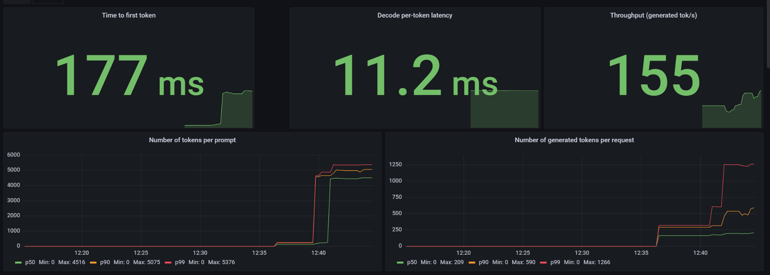
It works: Mixtral 8x7B on 2xH100 NVL using TGI

Slide 34
GB200- Future successor to both Hopper and Ada Lovelace
https://en.wikipedia.org/wiki/Blackwell_(microarchitecture)
2,5x faster than H100
2x memory
Native support for 4 Bit resolution
Sped up NVLink
https://www.heise.de/news/Nvidias-neue-KI-Chips-Blackwell-GB200-und-schnelles-NVLink-9658475.html

Slide 35
Evaluation

Slide 36

System Architeture
User:
Asking a Question
question
answer
Llm:
Generating an Anwer

Slide 37
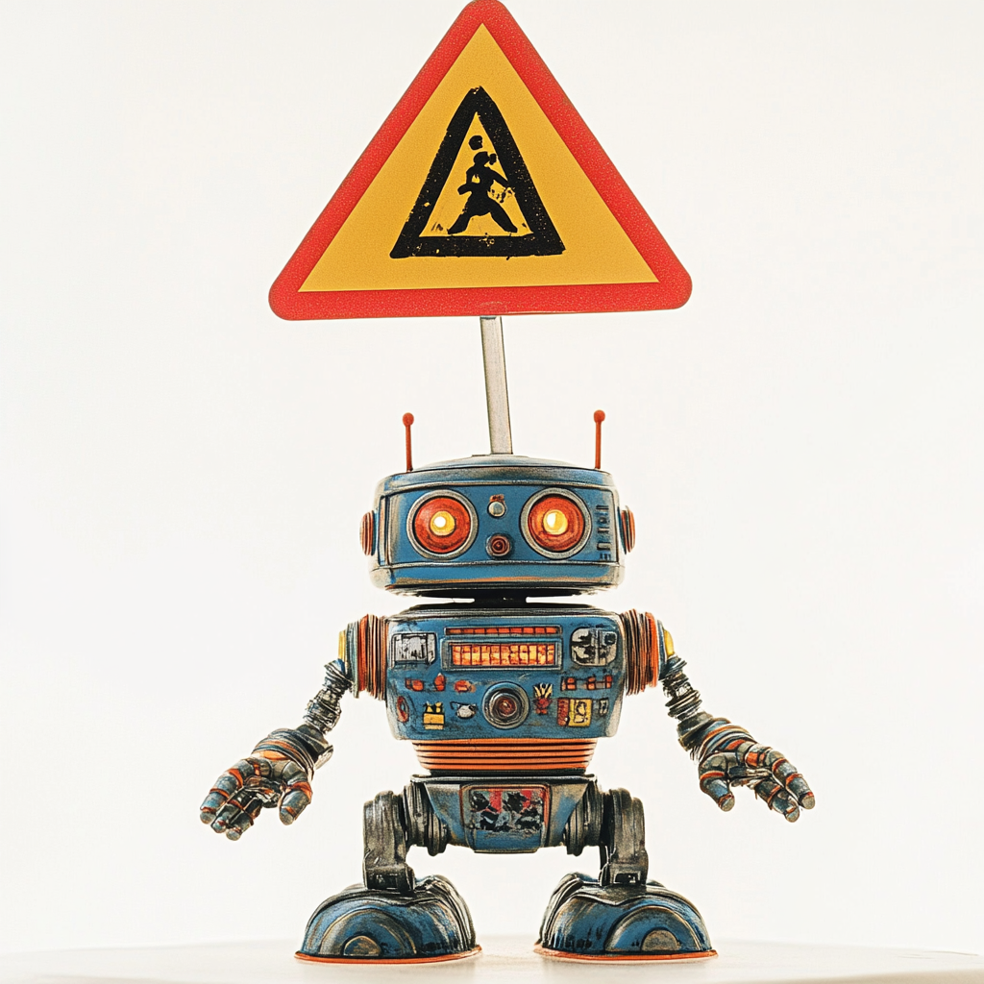
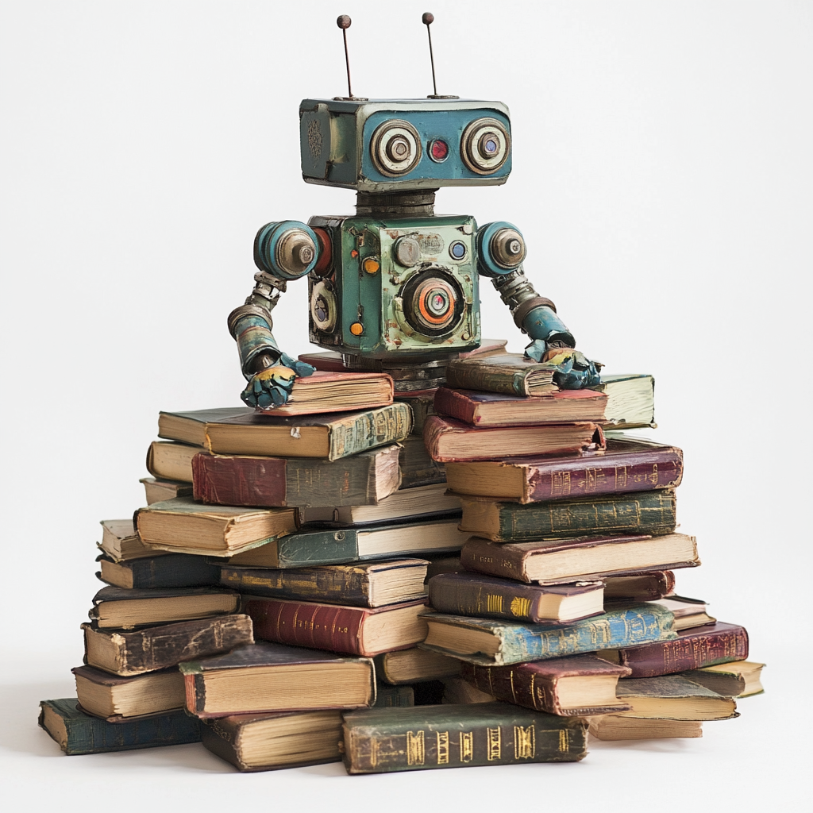

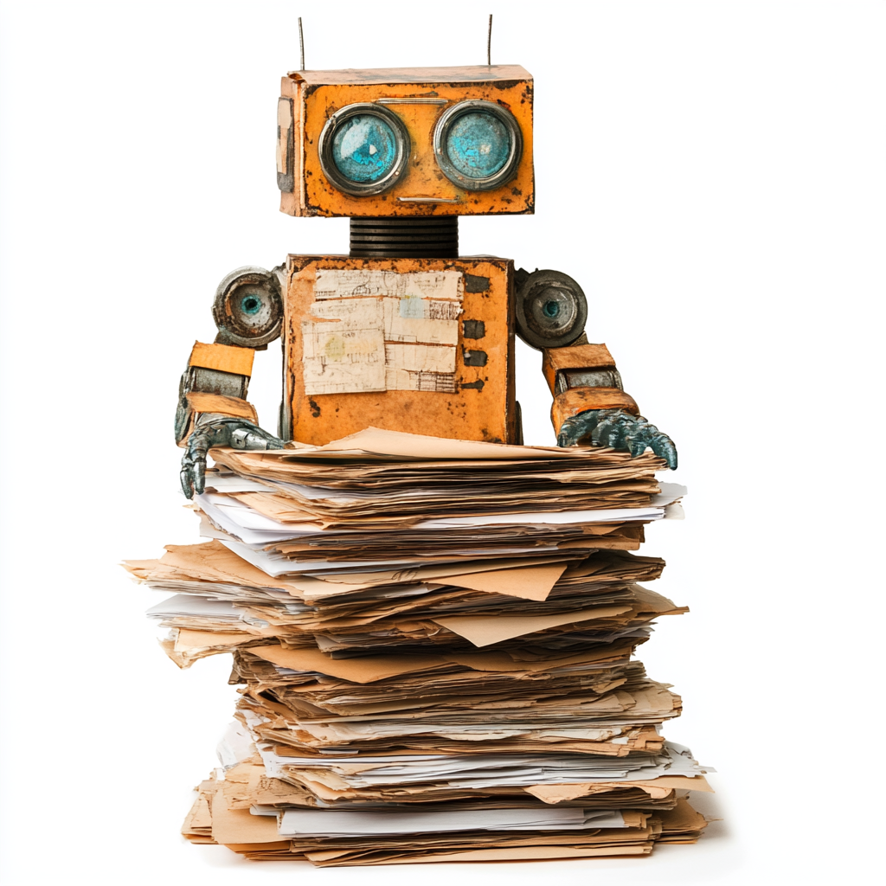
System Architeture
User:
Asking a Question
Doc Loader:
Image2Text
facts
Anonymizer:
Enforcing Privacy
answer
question
facts
SystemPrompt
Question
Facts
facts
Llm:
Generating an Anwer
Vector DB:
Searching facts matching
the question

Slide 38
Evaluation on text results
User:
Asking a Question
Text : answer 1 != answer 2
=> equality not an eval option
Categorical : may use equality for eval
answer
Llm:
Generating an Anwer

Slide 39
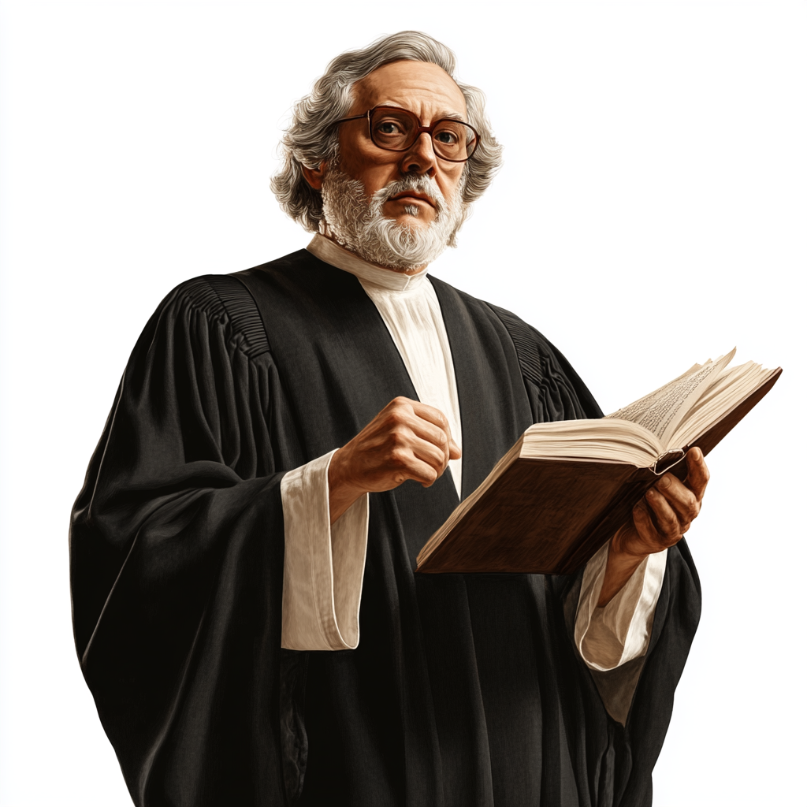
Evaluation on text results
Evaluation Criteria:
Length
Correct
Complete
Concise
Relevant
Contradiction free
Language
Style
…
Generation successful
User:
Asking a Question
answer
Statistics
Ground Truth ?
Human Eval
Llm:
Generating an Anwer

Slide 40
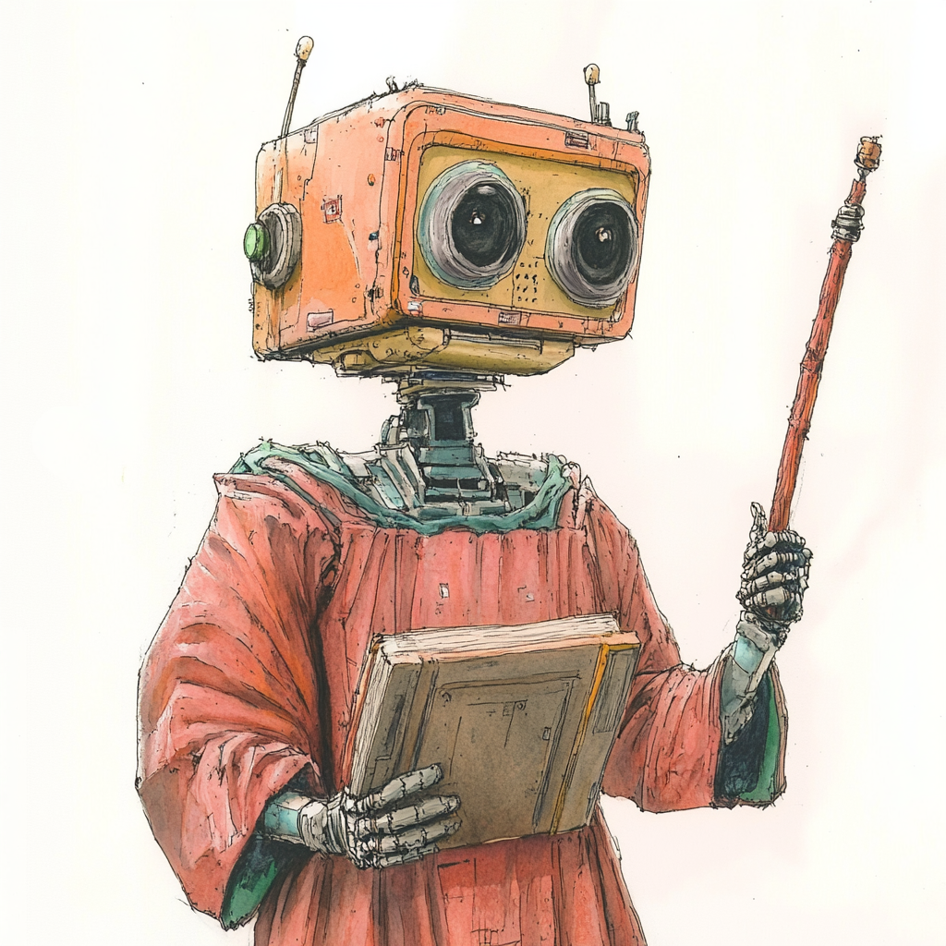
Evaluation on text results
Evaluation Criteria:
Generation successful
Length
Correct
Complete
Concise
Relevant
Contradiction free
Language
Style
…
User:
Asking a Question
answer
Statistics
LLM as a Judge
Ground Truth ?
Human Eval
Llm:
Generating an Anwer

Slide 41
LLM as a judge: idea
Prompt :
“You are an expert on english language, grading a students text with scores between 0 and 10…”
Input :
«Witing texts is painful, caus im making mitakes.”
Answer :
{'score': 1,
'reason': "The text contains multiple spelling errors, such as 'Witing' instead of 'Writing', 'caus' instead of 'because', and'mitakes' instead of'mistakes'. Additionally, the text is written in a non-standard dialect of English, which affects its clarity and coherence."}

Slide 42
Demo: Evaluation on Prem Notebook

Slide 43
System Architeture: Online Eval
User:
Asking a Question
Doc Loader:
Image2Text
facts
question
Answer Relevance
Conciseness
facts
Contextual Relevance
Anonymizer:
Enforcing Privacy
answer
SystemPrompt
Question
Facts
facts
Llm:
Generating an Anwer
Faithfulness
Vector DB:
Searching facts matching
the question

Slide 44
Demo: Online Eval ProPlanner

Slide 45
Evaluation Issues
Online Performance impact on LLM
Eval may call 10x more often, but have less output tokens
Which LLM do you use ? Same ? Faster ? Most Powerful ?
What Dimensions do you eval ?
Toxicity, Conciseness, Answer Relevance ?
Ground Truth available ?
Human Feedback from your users ?
Interpretation of the Scores ?

Slide 46
Your Experience ?
Anyone doing RAG ? In Production ?
Anyone already on Prem ?
Do you do evaluation ? By humans ?
What else do you use for evaluation ?

Slide 47
Eval Frameworks
DeepEval https://docs.confident-ai.com/
Ragas https://ragas.io/
TruLens https://www.trulens.org/
Evidently https://www.evidentlyai.com/
Ares https://ares-ai.vercel.app/

Slide 48
Wrap Up

Slide 49
Key takeaways

Slide 50
Collection of notebooks used
Quantization: https://colab.research.google.com/github/DJCordhose/practical-llm/blob/main/Assessment.ipynb
Evaluation: https://colab.research.google.com/github/DJCordhose/practical-llm/blob/main/Assessment.ipynb

Slide 52
Collection of notebooks used
SetFit: https://colab.research.google.com/github/DJCordhose/practical-llm/blob/main/Assessment_SetFit.ipynb
Microsoft Phi 3 3.8B: https://colab.research.google.com/github/DJCordhose/practical-llm/blob/main/Assessment_Phi_3_mini_T4.ipynb
Google Gemma 2 2B: https://colab.research.google.com/github/DJCordhose/practical-llm/blob/main/Assessment_Gemma_2_2B_T4.ipynb
Meta Llama 3.1 8B - Quantized to 4-Bit and 8-Bit: https://colab.research.google.com/github/DJCordhose/practical-llm/blob/main/Assessment_Llama_3.1_8B_Quantize_T4.ipynb
Meta Llama 3.1 8B: https://colab.research.google.com/github/DJCordhose/practical-llm/blob/main/Assessment_Llama_3.1_8B_Full_T4.ipynb
Mixtral 8x7B with extreme quantization: https://github.com/DJCordhose/practical-llm/blob/main/Assessment_Mixtral_8x7B.ipynb

Slide 53
LLM Drift Detection
score changes a lot
accuracy or
a criteria
distribution changes a lot, e.g.
length of inputs or outputs
processing time / latency
use univariate two-sample tests
choose test based on properties of samples
train an Encoder Model to tell old data from new data
if the model has predictive power, there must be a systematic change
https://www.evidentlyai.com/blog/data-drift-detection-large-datasets
https://www.evidentlyai.com/blog/open-source-llm-evaluation#drift-detection

Slide 54
Finding Drift in Embeddings
Embedding can be generated from text using encoder style embedding model
Can be as simple as raw encoder model without head
https://openai.com/index/new-embedding-models-and-api-updates/
drift detection methods (potentially with dimensionality reduction)
Euclidean distance on average embedding
Cosine distance on average embedding
Classifier model
Share of drifted embedding components
https://www.evidentlyai.com/blog/embedding-drift-detection
Failing Loudly: An Empirical Study of Methods for Detecting Dataset Shift: https://arxiv.org/abs/1810.11953

Slide 55



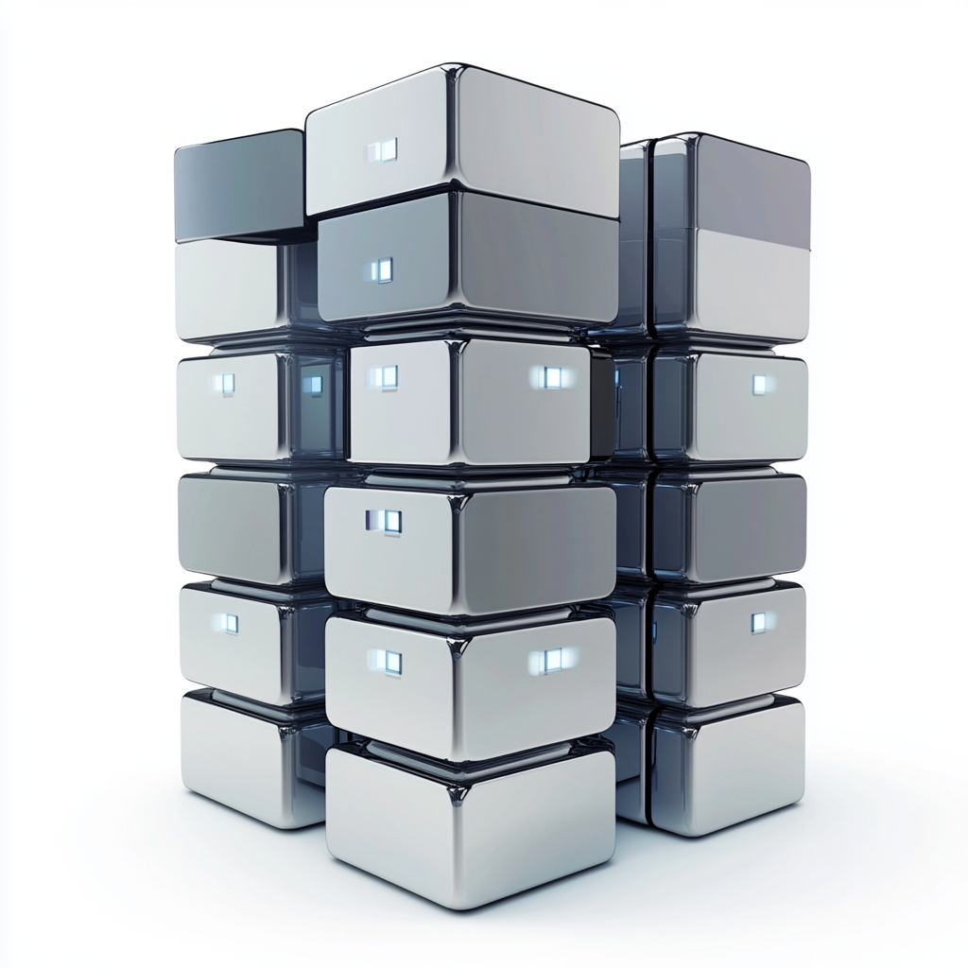


Beware of On Prem
King:
Pose a question
Answer relevant ?
Idea: Create Questions for Answer.
Are the similar to original question ?
Found facts relevant ?
Idea: % of facts relevant for query
Llm:
Create answer
Vector DB:
Find matching facts
Answer based on found facts ?
Idea: Create Statements from Answer.
% of Statements based on found facts.

Slide 56
Evaluation
Especially important for smaller / less accurate models
Standard Benchmarks only faint indication for actual task at hand
Need for a specialized evaluation set very likely

Slide 57
Quantitative vs Qualitative Evaluation
Quantitative Evaluation - Objective Measurement
measure performance objectively
common metrics: accuracy, precision, recall, F1-score, and mean squared error.
Qualitative Evaluation - Subjective Assessment
understanding and interpreting non-numerical data (e.g., text, images, or videos)
obtain deep insights into the underlying phenomena

Slide 58
Quantitative Evaluation for LLMs
A number is what we wish for
Single value
Speaking
Significant
Objective
However: What can be measured objectively often is not significant

Slide 59
Qualitative Evaluation for LLMs
A subjective “feeling” / “impression”
What we often have to resort to
Works best with small set of hand picked examples
If larger amounts needs more sophisticated approaches
Embedding -> Dimensionality Reduction -> Clustering
LLM as a judge

Slide 60
Regression Testing
Checks for stability and degradation of criteria / properties
Challenged when changing
Prompts
TAG-Sources
Model Version
Model Architecture

Slide 61
Criteria Tests
Text statistics. Evaluate simple properties like text length.
Text patterns. Detect specific words or regular patterns.
Model-based evals. Use ready-made ML models to score data (e.g., by sentiment).
LLM-as-a-judge. Prompt LLMs to categorize or score texts by custom criteria.
Similarity metrics. Measure semantic similarity between pairs of text.
https://docs.evidentlyai.com/get-started/tutorial-llm

Slide 62
LLM-as-a-judge
Use the most powerful LLM you have at hand as a judge for an answer
Request categories in prompts
Scores often do not work very well
Explanation texts only make judgements hard to track
Describe the category to test well
Use Judge as part of a conversation or on output only
Example:
Personally identifiable information: https://www.evidentlyai.com/blog/open-source-llm-evaluation#llm-as-a-judge
Conciseness: https://docs.evidentlyai.com/get-started/tutorial-llm#llm-as-a-judge

